Slide 1
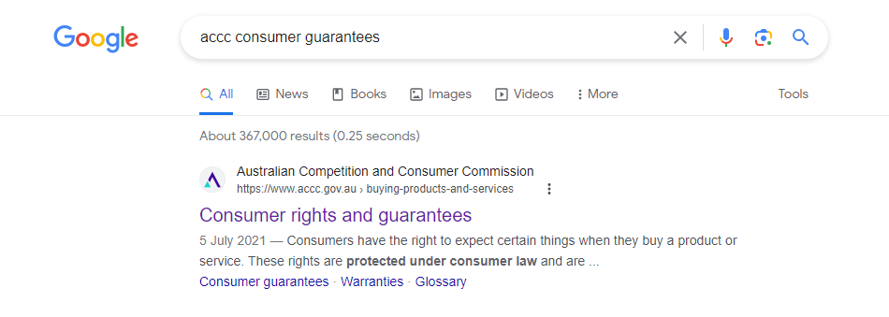

Date:13/11/2023
Daily Review – Key topics from previous lesson –
ACCC- SEARCH consumer guarantees
Shonky Award- choose the product you want to know about. Can use a product from any year.
Words – Definitions I need to know:
 Consumer law - Under the Australian Consumer Law, consumers have the same protections and expectations about business conduct wherever they are in Australia.
Key concepts yesterday’s lesson covered:
PART A: ACCC- (Australian Competition and Consumer Commission)
Consumer law
PART B SHONKY AWARDS Research
Key directional word of the day:
Create

Slide 2
Topic: ASSIGNMENT 1
Learning Intentions (LI)
Success Criteria (SC)
Explore various products that have breached consumer rights
Create a poster that informs consumers about a “shonky” product

Slide 3

Today
Hand in booklets
Submit digital posters on connect
Remember your reference recording sheet
Validation on page 11

